Slide 1
https://github.com/CurryBay/SIAPrototype

Slide 2
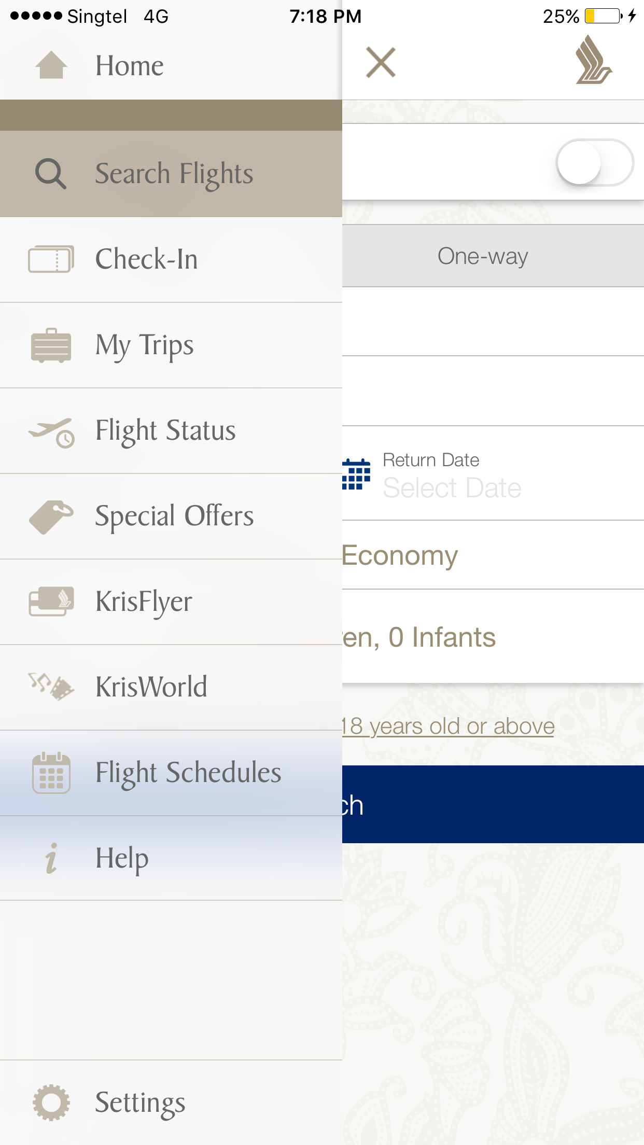
Home
Q
Search Flights
My Journey
Check In
KrisFlyer
KrisWorld
Flight Schedules
Help
Log In
Settings

Slide 3
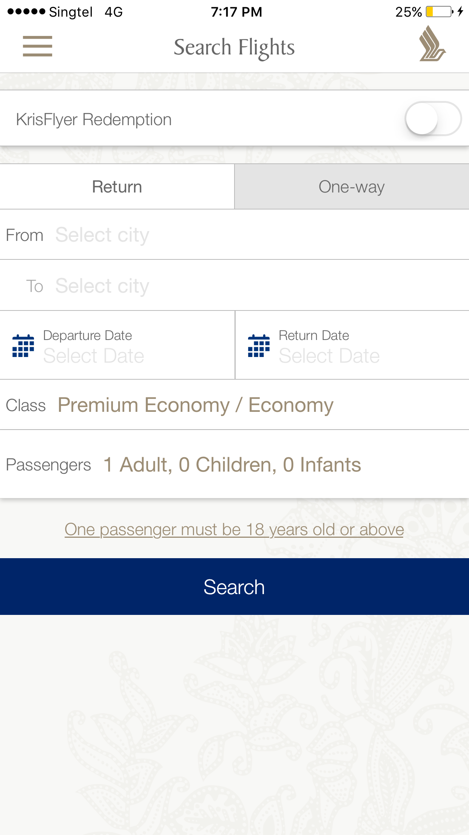
Search Flights
Search Flights
KrisFlyer Redemption
KrisFlyer Redemption
Return
One-Way
Return
One-Way
From:
From:
To:
To:
Departure Date:
Return Date:
Departure Date:
Return Date:
Class:
Class:
Passengers
Passenger 1:
Passenger 2:
Passenger 3:
Search
Search

Slide 4
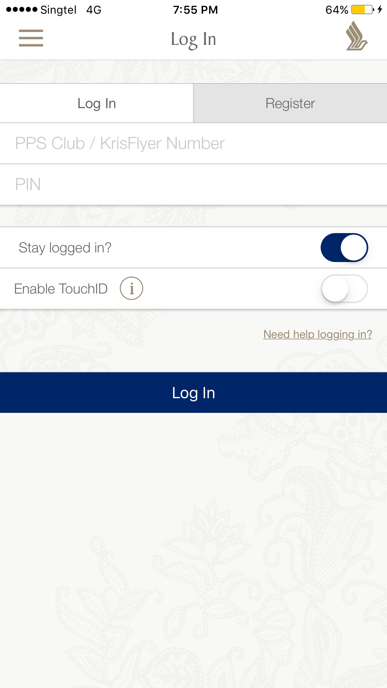
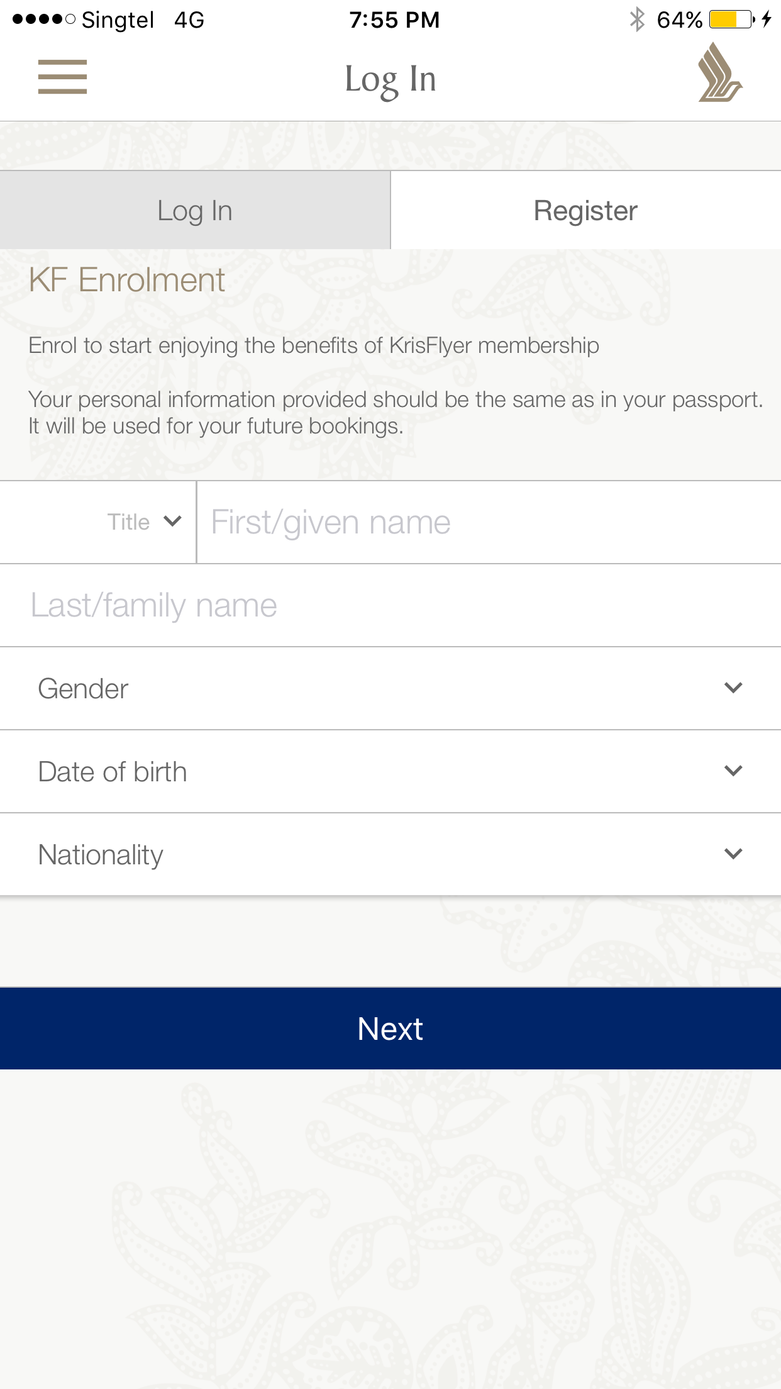
Log In
Log In
Register
Title:
First / Given Name:
Last Name:
Gender
Date Of Birth
Nationality
Email:
Home Address:
Next
Sign Up With FaceBook
Sign Up With Google +

Slide 5
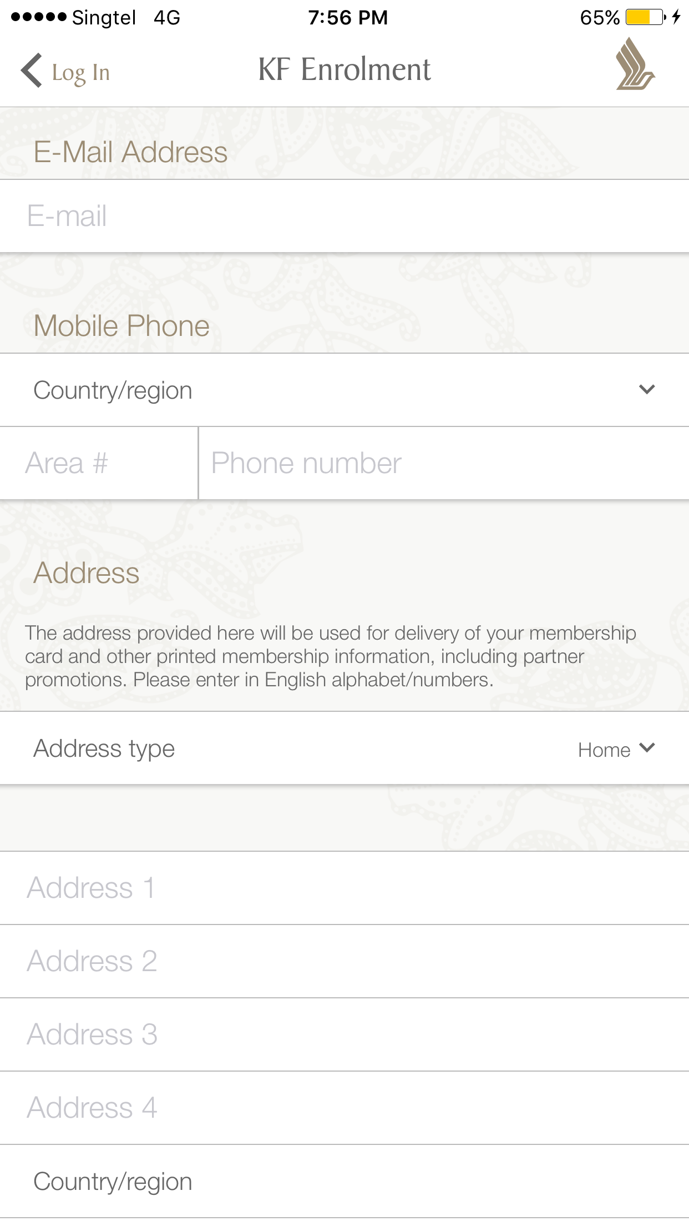
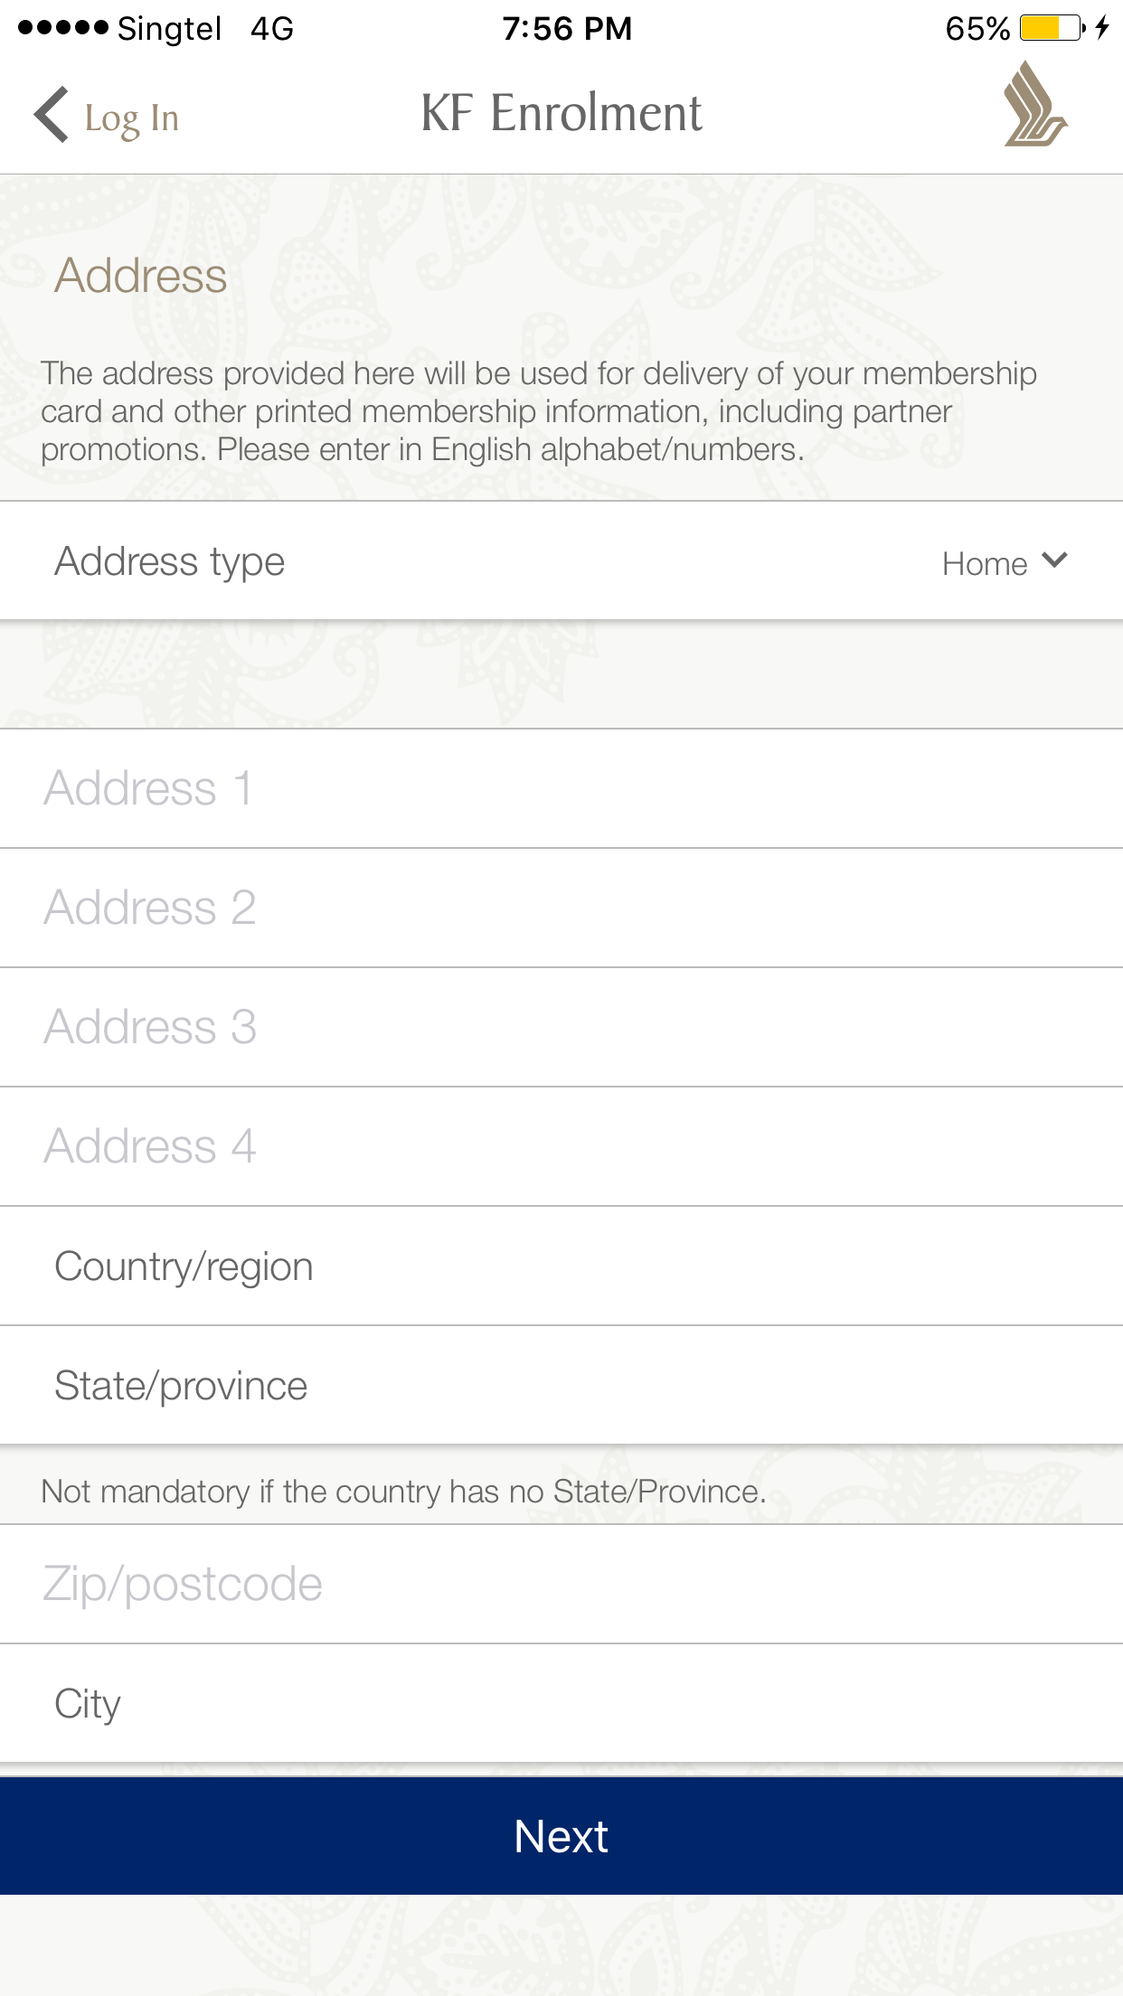
KF Enrolment
Area #
Mobile Phone Number:
Country / Region:
City:
Zip / Postcode:
Passport Number:
Next

Slide 6
My Journey
My Journey
My Journey
Online
Map
1
Check In
4
Transit:
PVG
Offline @ T3
Counter 2
Explore
07/09/16, 9.30PM (SGT)
5
Flight:
SQ8562
Seat 46C
2
Baggage
Deposit
Max Weight: 20kg
To: New York (JFK)
Buy More Weight
Status: Unavailable
07/09/16, 9.30PM (SGT)
07/09/16, 3AM (CST)
3
Flight:
SQ8337
Seat 37A
Seat 23B
6
Flight:
SQ9325
To: Shang Hai (PVG)
To: Shang Hai (PVG)
Status: Landed
Status: Unavailable
07/09/16, 10.30PM (SGT)
21/09/16, 9PM (GMT -4)

